Slide 1
Shock wave interaction with abrupt area changes
Eric Qiu
17 March 2022
Prepared for ben t. zinn combustion laboratory
Notes:
Next week: Do it from scratch

Slide 2
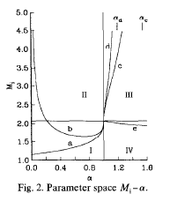
BACKGROUND
Incident Mach Number | Pressure Ratio
1.1 | 1.56
1.3 | 3.49
1.5 | 7.00
1.85 | 21.44
2.5 | 145.34

Slide 3
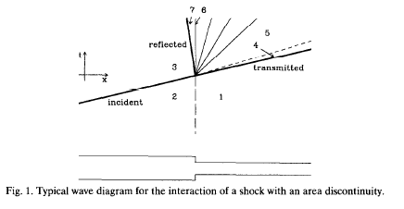
CONT.

Slide 4
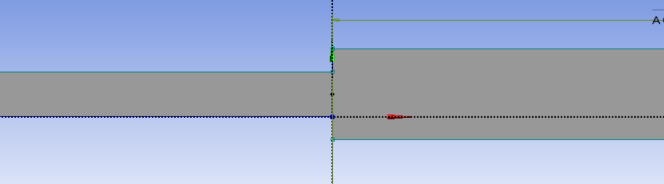
Experimental set-up
Assumptions:
Dimensionality: the problem is described in two dimensions.
Perfect gas equations of state.
Negligible viscosity along the tube (geometry): neglect viscous terms in the simulation.

Slide 5
Experimental set-up: specific geometry
1000 mm
1000 mm
15 mm
30 mm
P(light blue) = Driver
P(middle blue) = Driven
P(dark blue) = Downstream

Slide 6

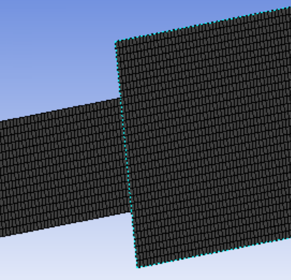
Experimental set-up: Mesh SIZING & JUSTIFICATION
Left side is shock tube from previous experiment: same mesh sizing was used (1mm divisions in both dimensions)
Notes:
Convince my audience that the simulation that I did reflects real-life phenomenon
Justify my choices for mesh dimensions and time step

Slide 7
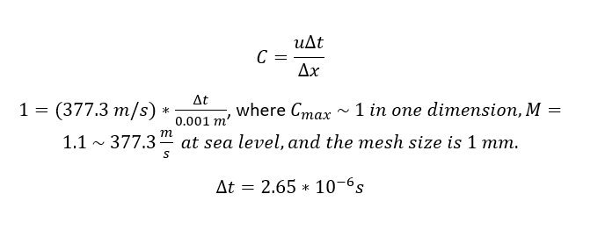
Time-step

Slide 8
Results

Slide 9

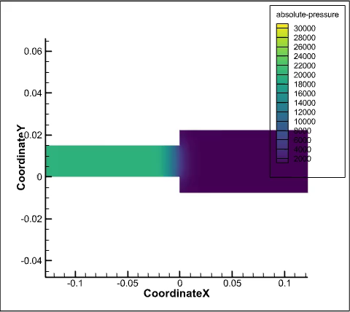
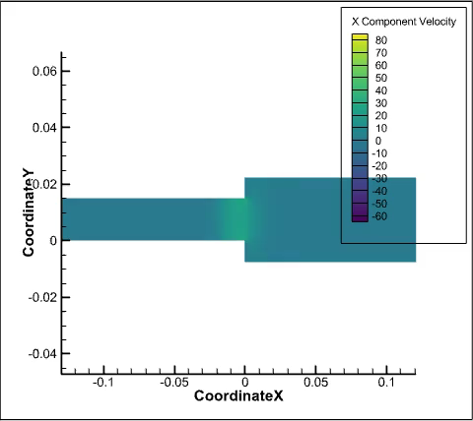
Notes:
Results: What is physically happening, have an educated hypothesis of what’s probably going to happen. Describe what physical phenomena is showing

Slide 10
Conclusions

Slide 11
